Slide 1
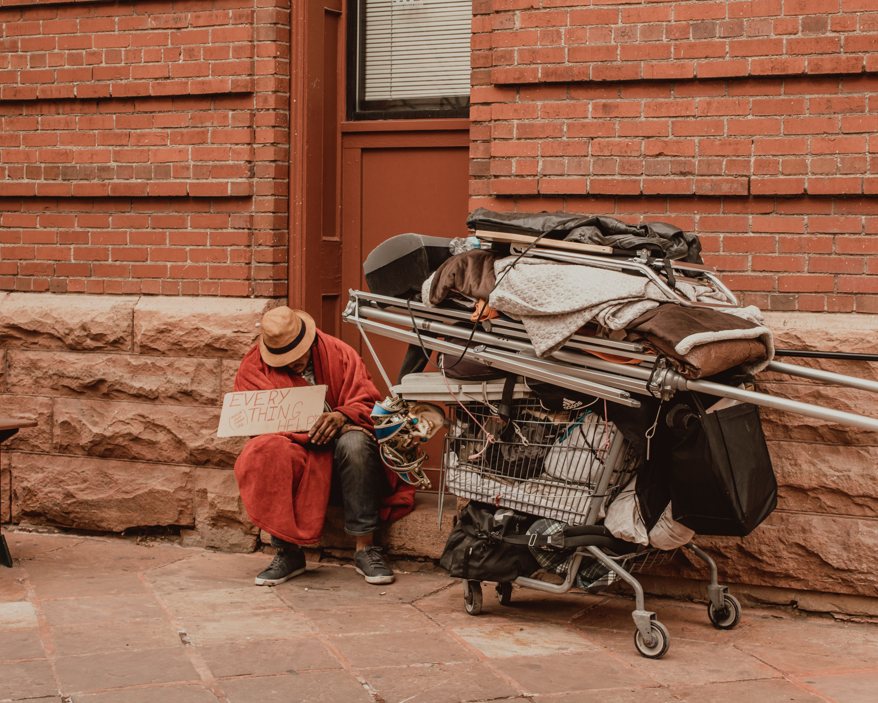
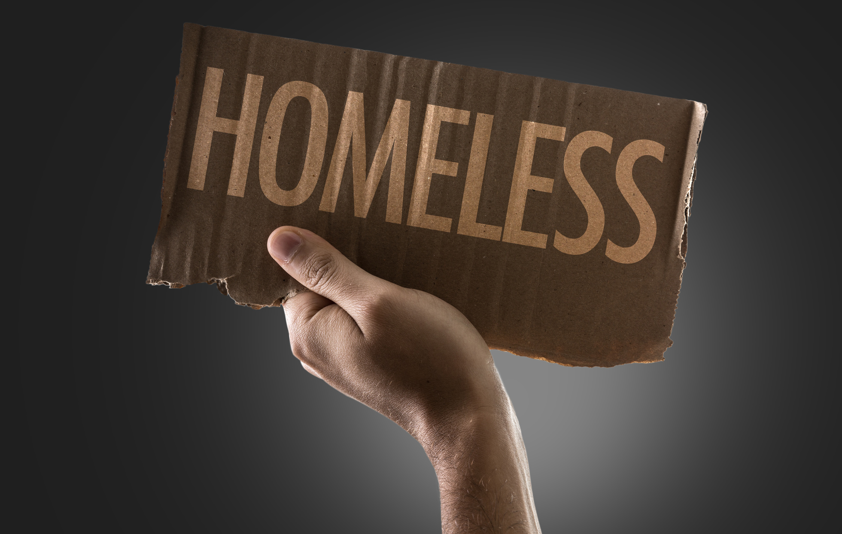
Fayetteville/Cumberland County
2022 Point In Time Count
Cumberland County Community Development

Slide 2

475
Sheltered and Unsheltered Homeless Individuals and Families
On the night of January 27, 2022, there was a total of 475 sheltered and unsheltered homeless individuals

Slide 3
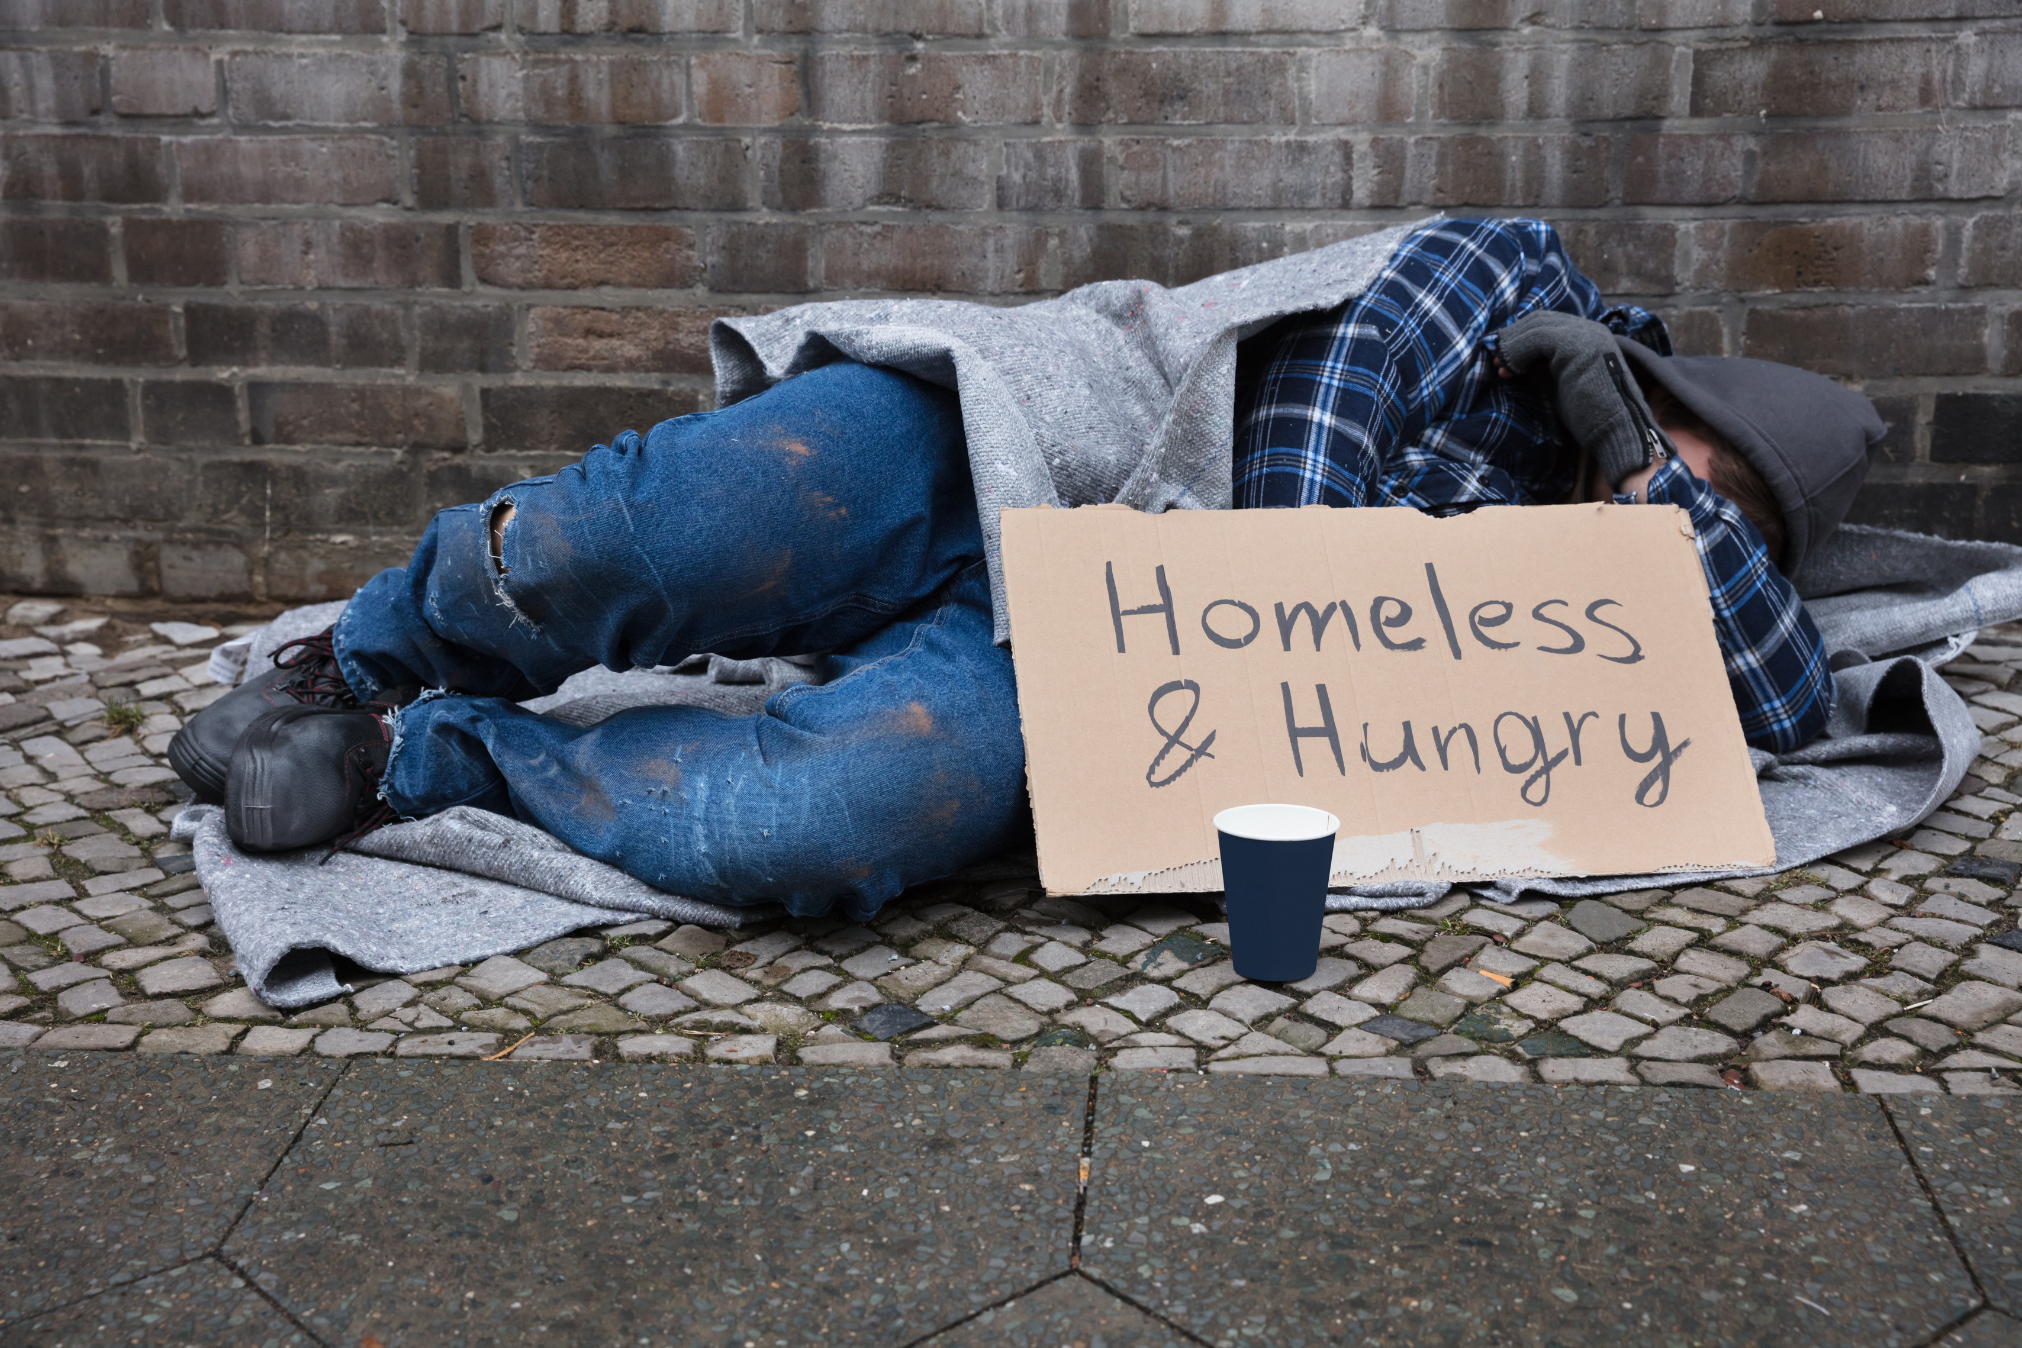


392
Unsheltered Homeless Individuals and Families
From the time period of:
January 26, 2022 - January 27, 2022
(392 Unsheltered)
people were experiencing homelessness
Unsheltered Count

Slide 4



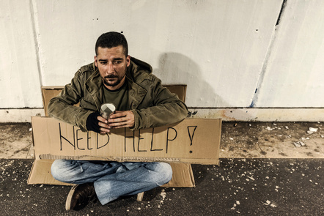

Total Veteran Count
Emergency Shelters
Safe Havens
Sheltered Transitional Housing
Unsheltered
Total
Total Number of Households: 0
Total Number of Persons: 0
Total Number of Veterans: 0
Total Number of Households: 1
Total Number of Persons: 2
Total Number of Veterans: 1
Total Number of Households: 19
Total Number of Persons: 22
Total Number of Veterans: 19
Total Number of Households: 20
Total Number of Persons: 24
Total Number of Veterans: 20

Slide 5


45
Homeless Adults admitted to having a serious Mental Illness

Slide 6

34
Homeless Adults admitted to having a Substance Use Disorder

Slide 7

0
Adults with HIV/AIDS

Slide 8

20
Adult Survivors of Domestic Violence

Slide 9


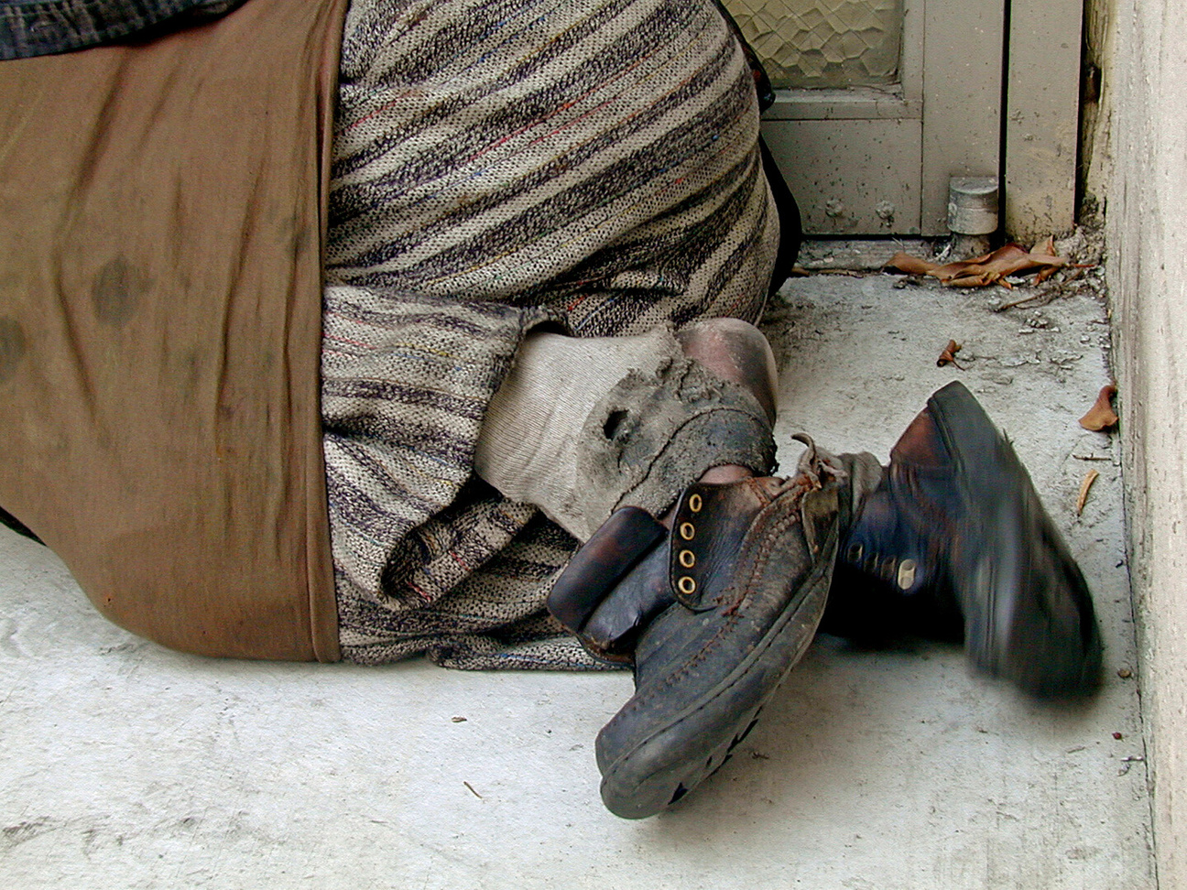
HOMELESS
Homeless: An individual who lacks a fixed, regular, and adequate night time residence: as well an individual who has a primary nighttime residence that is a supervised publicly or privately operated shelter designed to provide temporary living accommodations, an institution that provides a temporary residence for individuals intended to be institutionalized; or a public or private place not designed for, or ordinarily used as, a regular sleeping accommodation for human beings.

Slide 10


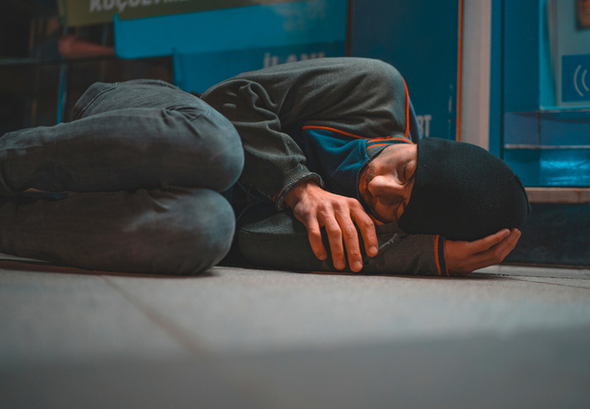
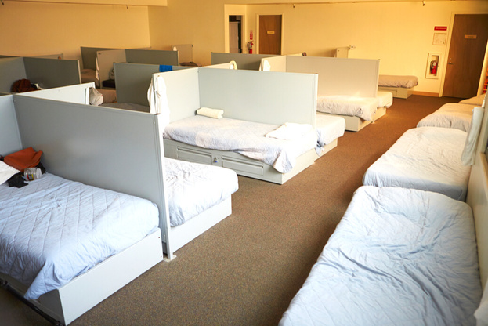

Three (3) Different Types of Homelessness
Sheltered Homelessness
Imminent Risk of Homelessness
Unsheltered Homeless
Those who are living in uninhabitable places for people to normally dwell such as: living on the street, in cars, abandoned houses, public benches, parks, doorways to businesses and other places that can be found for shelter.
Individuals who are not living on the street but are not living on their own either. Those living in transitional housing (temporary housing) such as domestic violence shelters, emergency shelters, hotel, motels and safe havens.
Those who will lose their primary residence within 14 days and they have no other housing and lack the resources to obtain housing. Those living on the couches of another persons' home and depending on the kindness of others.
I

Slide 11
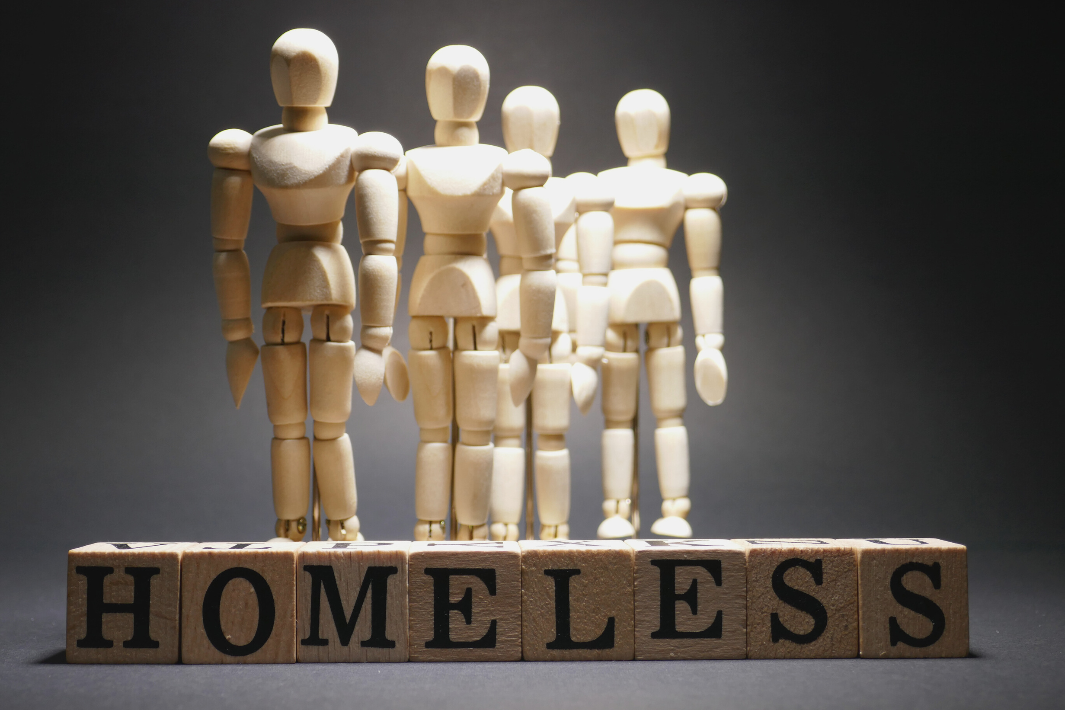

All homeless people are lazy and don't want to work
Homeless persons choose to be homeless.
All homeless persons abuse alcohol and drugs.
Helping homeless persons only enables them
HOMELESSNESS
IT'S MORE THAN YOU KNOW!
MISCONCEPTIONS
Those misconceptions are not true, homelessness is closer to one's door than you know.
SERIOUS TRUTH
Many may not realize it, but any individual or family can possibly experience homelessness by the loss of as little as two monthly paychecks due to an unforeseen event that could arise.
IT COULD HAPPEN TO YOU

Slide 12





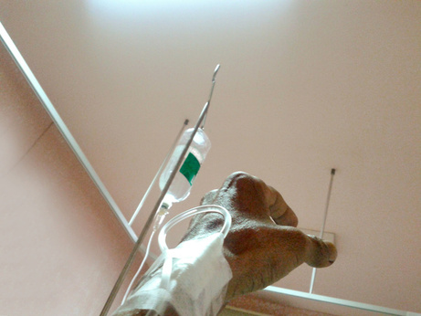


Most Common Causes of Homelessness
    Loss of Employment.
    Family Crisis: Divorce, loss of loved one, medical crisis.
    Lack of affordable housing, eviction
    Mental and or Physical Disability
    Drugs/Alcohol
    Domestic Violence
    Incarceration
    Poverty

Slide 13



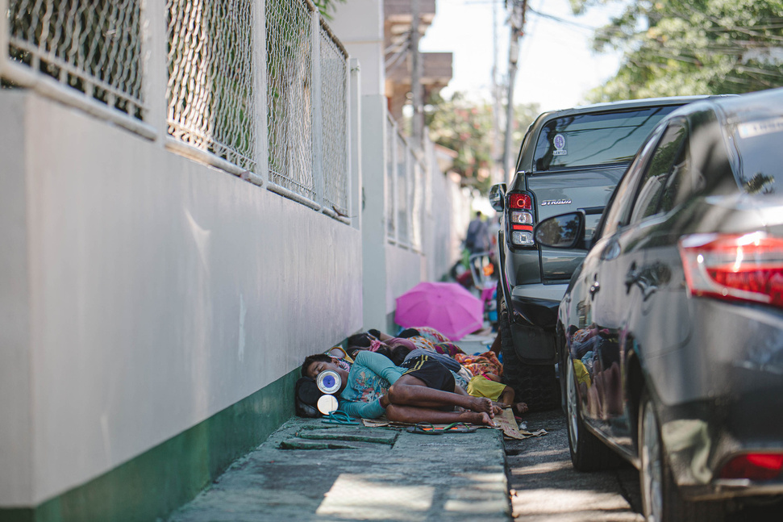
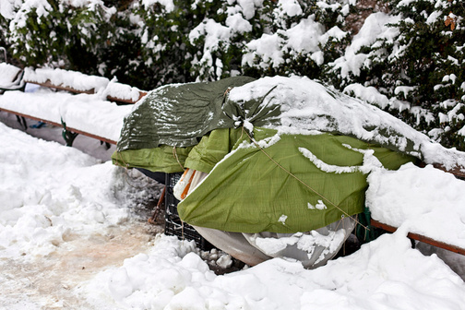
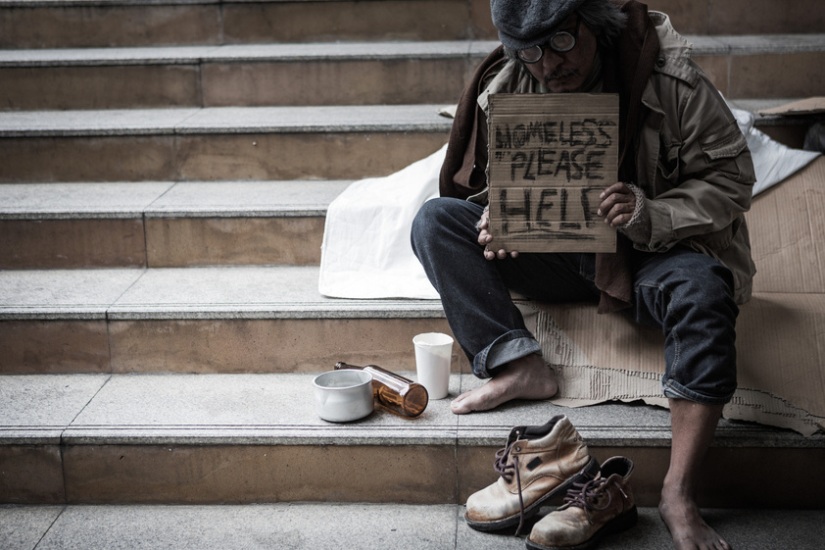
Understanding the Point in Time Count (PIT)
This report is intended to provide the community with vital information regarding the many different characteristics of our homeless community. The collection of surveys is one way we use to count our homeless community. Although the surveys are thorough, they do come with limitations. The task of counting those who are experiencing homelessness is not an easy task to complete in only one night.

Slide 14
Understanding the Point in Time Count (PIT)
Although it is our goal to reach every homeless person in our community, it is almost nearly impossible to locate everyone. This count is only as accurate as the number of individuals that are located. The Point in Time Count is a snapshot of our community. These snapshots are taken each year in the hope that over a course of time we are able to observe changes and evaluate our progress in our goal to end homelessness and create an environment where everyone can live in a safe and comfortable dwelling.

