Slide 1

2024 Community Health Needs
Assessment Preliminary Results

Slide 2
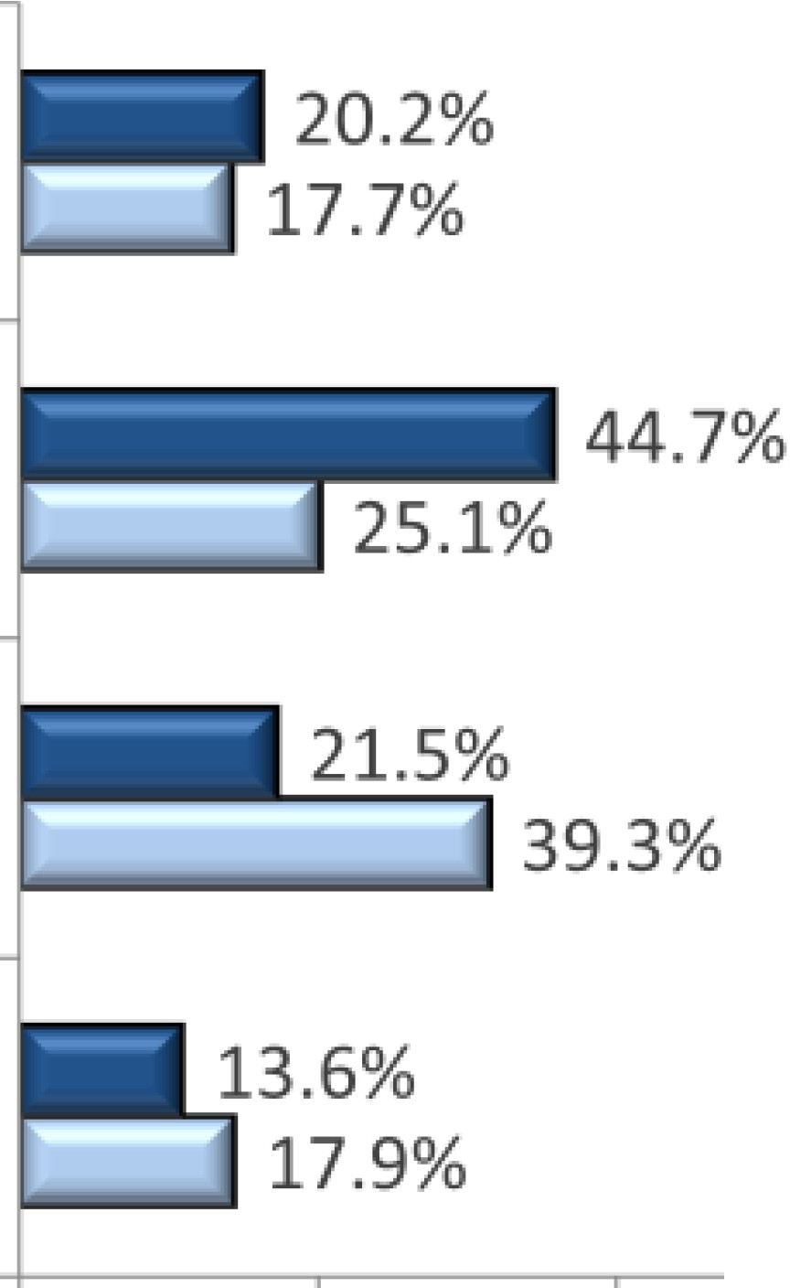
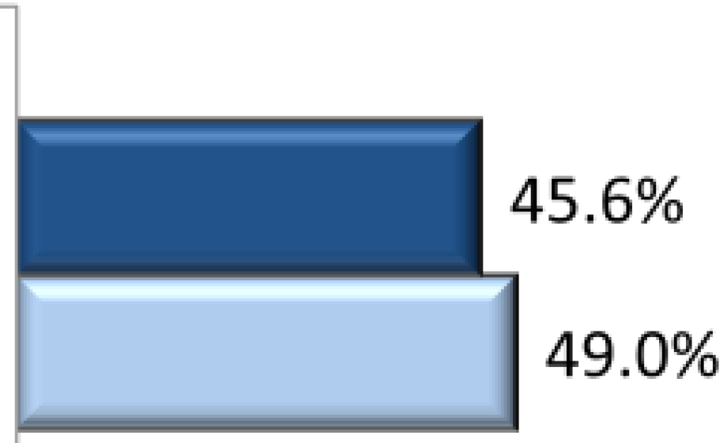
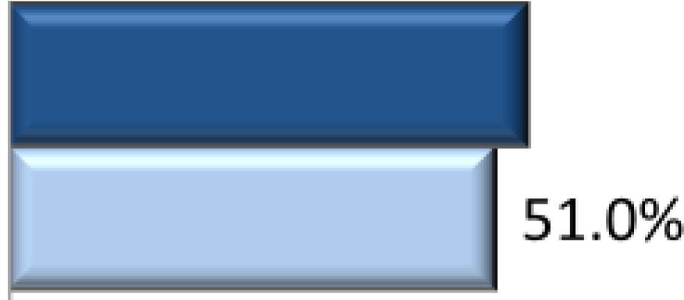
County Overview: Demographics
Cumberland County:
North Carolina:
337,037 persons
19% veterans
Median age: 31.7 years
10,765,678 persons
7.8% veterans
Median age: 39.2 years
Age Profile
Sex Profile
<15
Male
15 -44
Cumberland County
45 - 64
54.4%
North Carolina
Female
65+
0.0%
25.0%
50.0%
75.0%
10 0.0%
0 .0%
25.0%
50 .0 %
75.0%
100.0 %
Source: ESRI, 2023
ASCENDIENT I 7
r
CUMBERLAND
Department of Public Health
cumberlandcountync.gov/health
cou y
NORTN (AROLINA

Slide 3
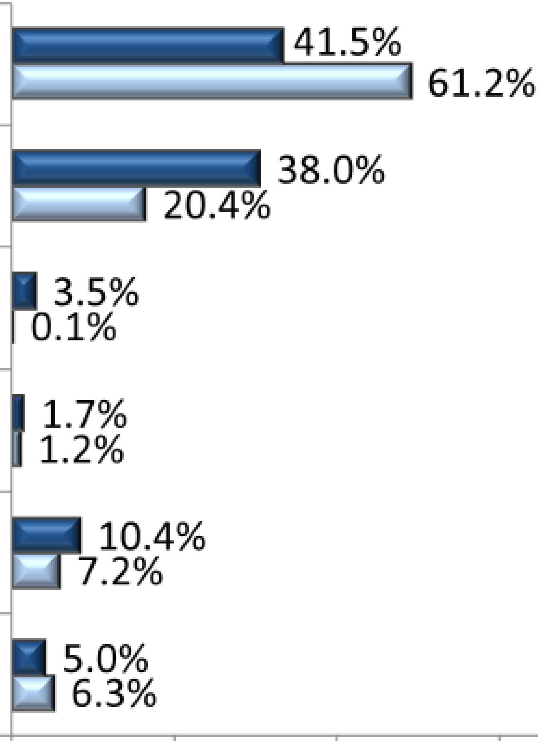


'1 County Overview: Diversity Profile
Cumberland County:
North Carolina:
6.1% foreign-born
12% of households speak a language other than English at home
18% of popu lat ion with a disability
9% foreign-bor n
12% of households speak a language other than English at home
13% of pop ulat ion with a disability
Race Pr·ofile
Ethnicity Profile
White
Non­
Hispanic or Latino
87.6%
Black
88.6%
Asian/NHPI
Cumberland County
AIAN
Two or more races
Hispanic or Latino
12.4%
North Carolina
11.4%
Other
0.0% 25.0% 50.0 %
So urce; ESRI, 2023
Note; Individ uals identi fied as Hispanic or Lati no may be of any race or ethnici ty .
75 .0%
100.0%
0.0%
25.0%
50.0 %
75.0%
10 0.0 %
" Ase D ENT I s

Slide 4
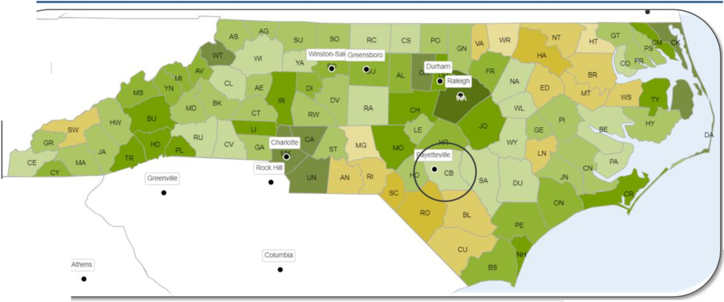




'1 County Overview: Health Outcomes Ratings
Knoxville
•
II
LEAST HEALTHY IN US
HEALTHIEST IN US
C berland Coun y
V
Cumberland County falls behind the national and state averages for health outcomes
Lea s
eal I y ir U S
ealthies ir US
State A erage
Source: Robert Wood Joh nson Foundation, County Health Ranking s
The "Health Outcomes" category includes data indicators related to Length of Life and Quality of Life (including Mental Health, Physical Health and M aterna l/ Infant Health) .
ASCEND1ENT I 19

Slide 5

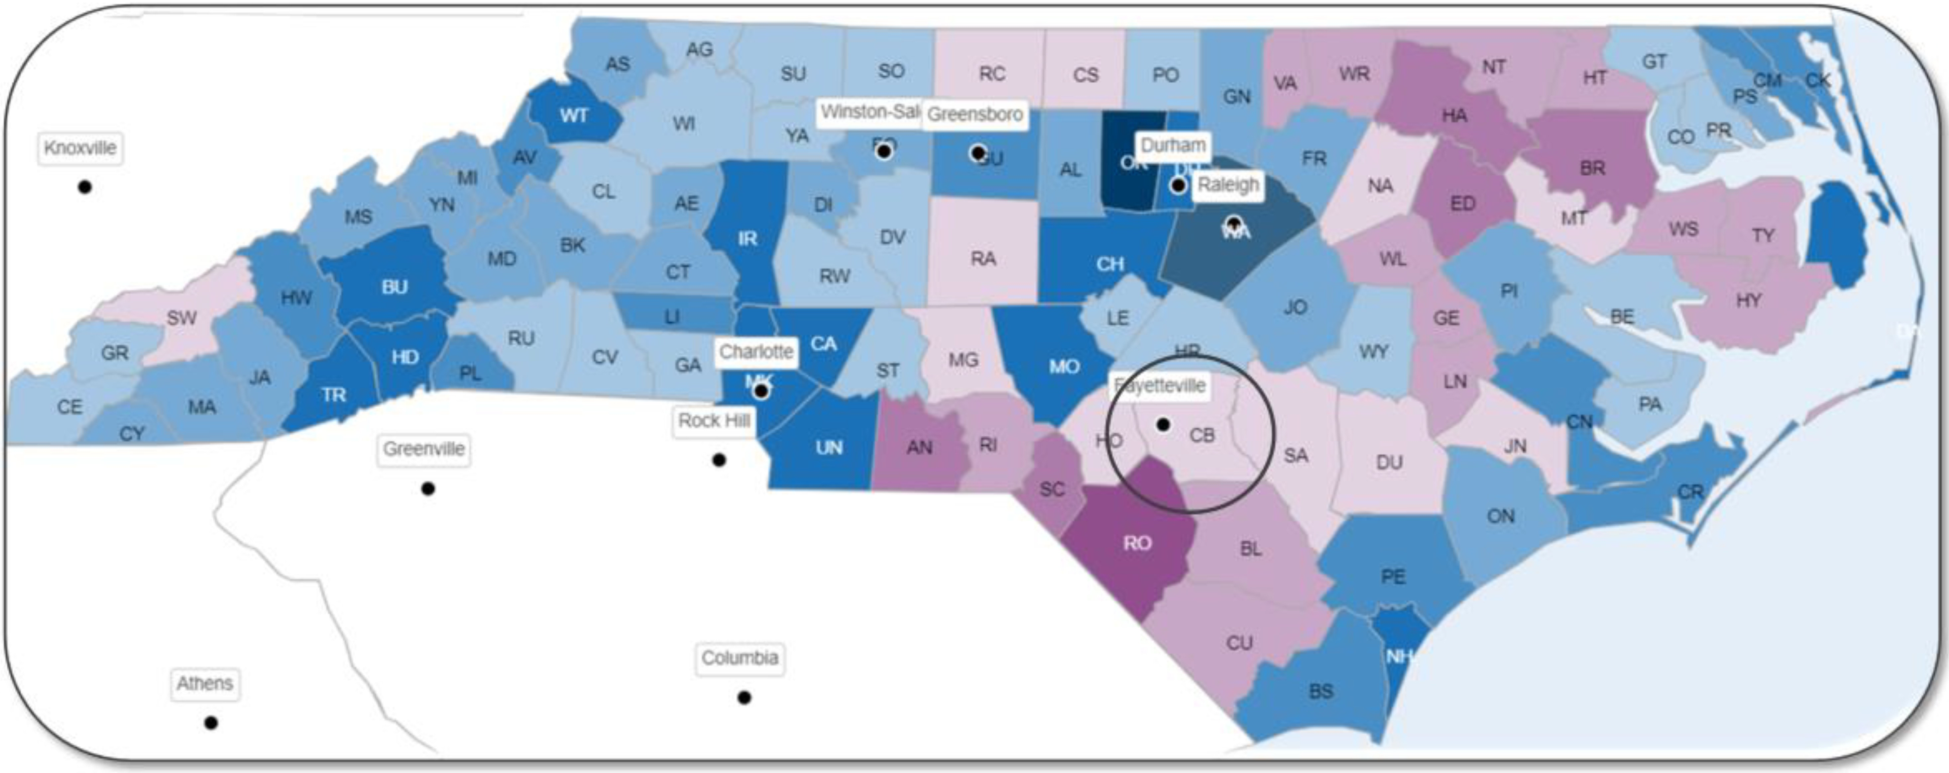


County Overview: Health Factors Ratings
LEAST HEALTHY IN US 1111 1111 1111 ml 1111 HEALTHIEST IN US
Cumberland County falls behind the national and state averages for health factors
Cumberla, d Co I y
e
ea!" hiest ir S
V
Leas
ealt y i US
'at ior al Avera0 e
ate Average
So urce: Robert Wood Johnson Foundation, County Health Rankings
The "Health Fac t ors'' category includes data indicators related to Health Behaviors (including Tobacco Use, Diet & Exercise, Alcohol & Drug Use and Sexual Activity), Clinical Care (including Access to Care and Quality of Care), Social and Economic Factors (including Education, Employment, Income, Family & Social Support and Community Safety) and Physical Environment (including Air & Water Quality and Housing & Transit).
ASCEND1ENT I 20

Slide 6





'1 Secondary Data Methodology: Process Overview
Example:
Ratio of population to health professionals Rate of preventable hospit al stays
Compile and analyze individual data measures
Example: Category: Clinical Care
Focus Areas: Access to Care
Quality of Care
Identify "co:mmon the1mes" and develop categories and focus areas
Step2
Identify preliminary priorities based on levels of demonstrated and/or expressed need
Step 3
" Ase D ENT I 23

Slide 7
'1 Secondary Data Methodology: Outcomes and Factors
Lagging Indicators
Health Outcomes
What do we want to improve in our county?
Leading Indicators
HeaIth Factors
What do we need to focus on to make those improvements?
" Ase D ENT I 24

Slide 8

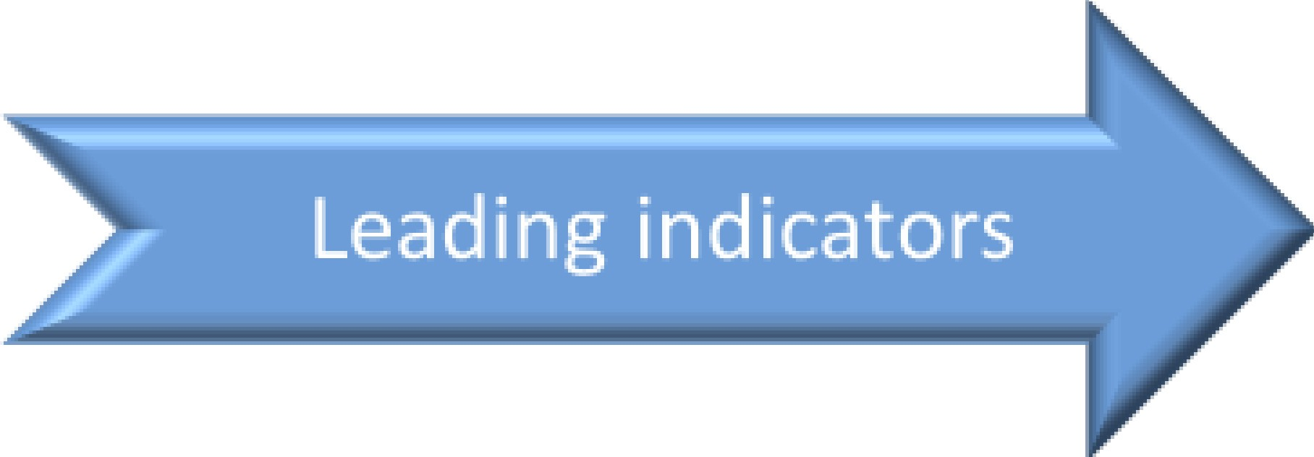
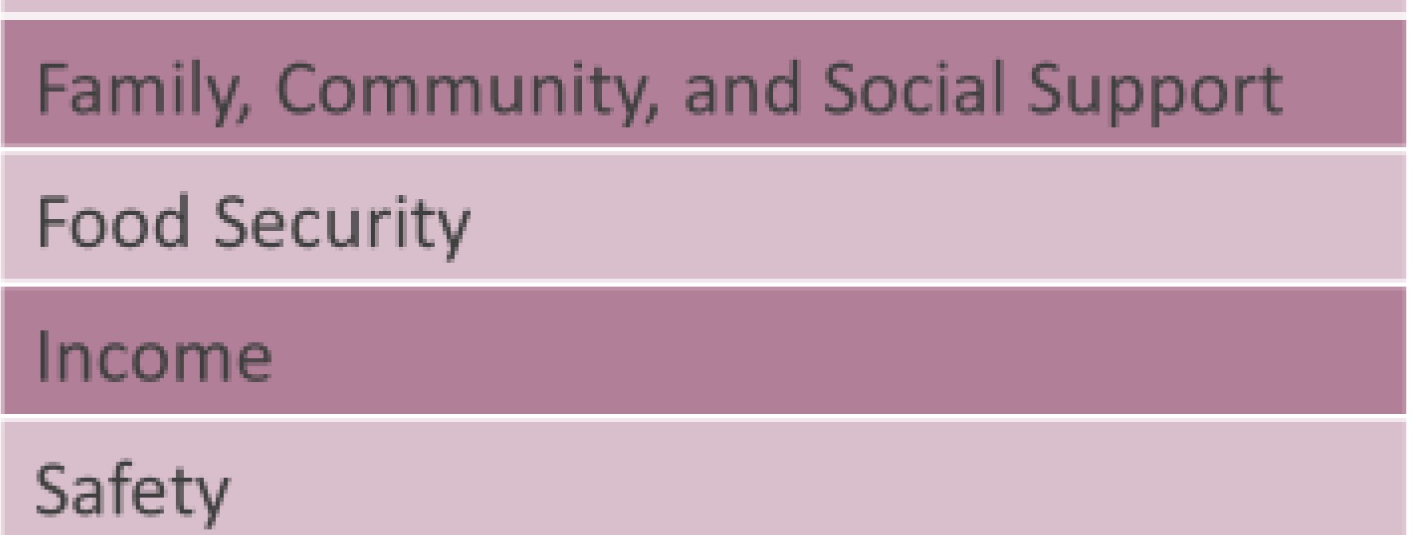
'1 Secondary Data Methodology: Population Health Model
r ·{ Le_n_g_ t_h_o_ _f _L ife
J ..... Maternal and Infant Health
,
.....
l·L..Physical Health
Health Outcomes
L.{ u _u_a_nt v__o_f_Life
j Mental Health
.......
····I
Clinical Care
Access to Care
L.. Quality of Care
.......
Diet and Exercise Sexual Health
=-····
Health Behaviors
Substance Use Disorders Tobacco Use
:·····
.......
Built Environment Environmental Quality Housing and Homelessness
Transportation Options and Transit
Health Factors
,
...... Physical Environment
...
.J
Education
Employment
......
Social and Economic Environment
" Ase D ENT I 2s

Slide 9


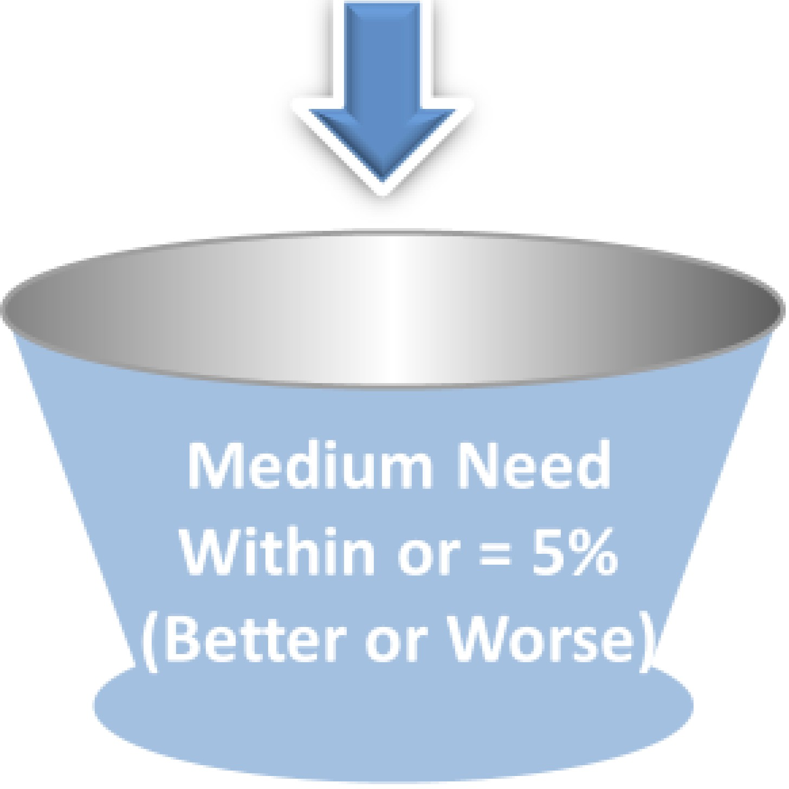

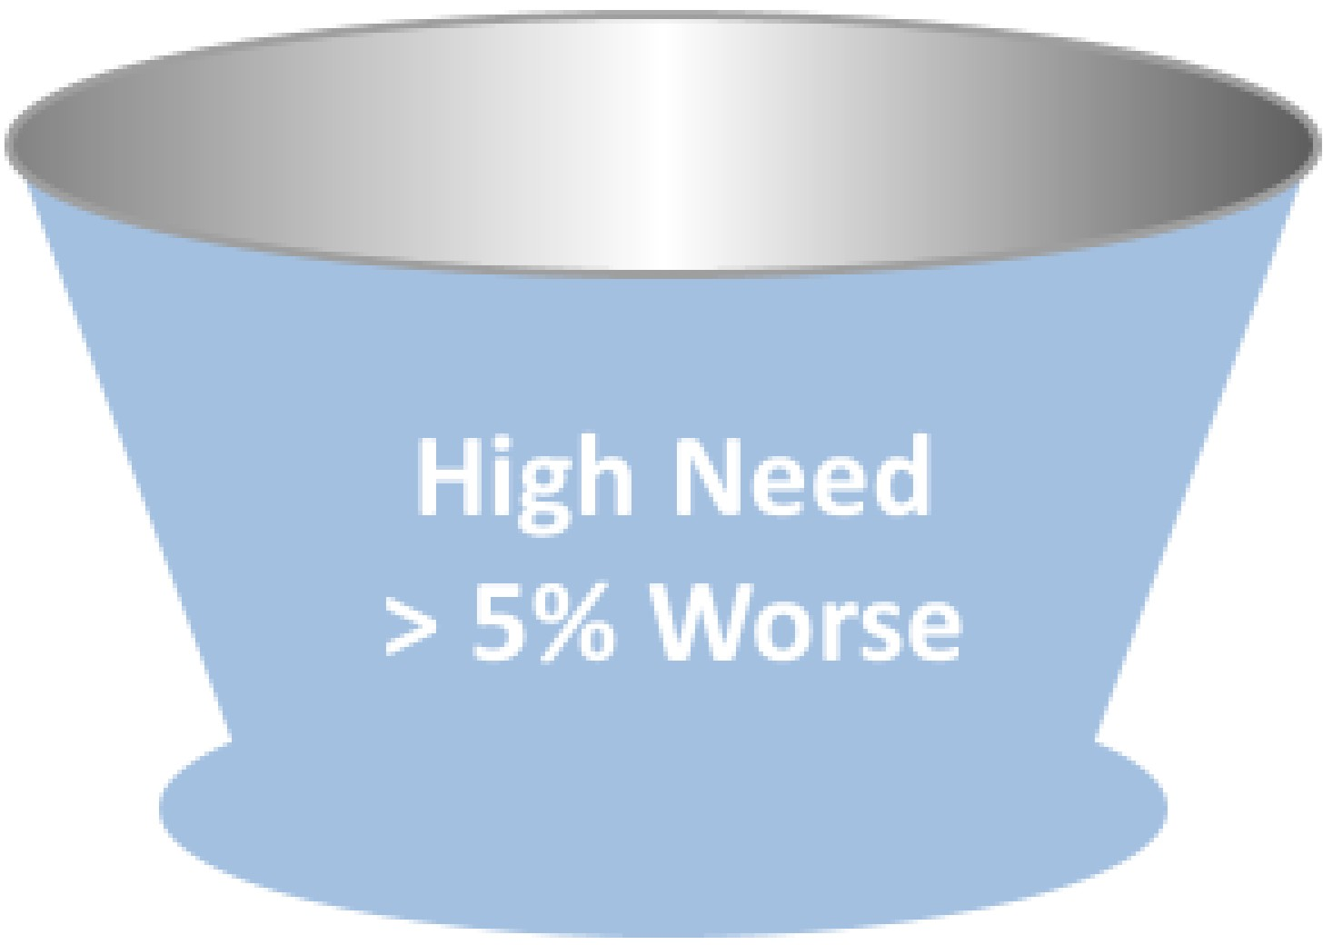
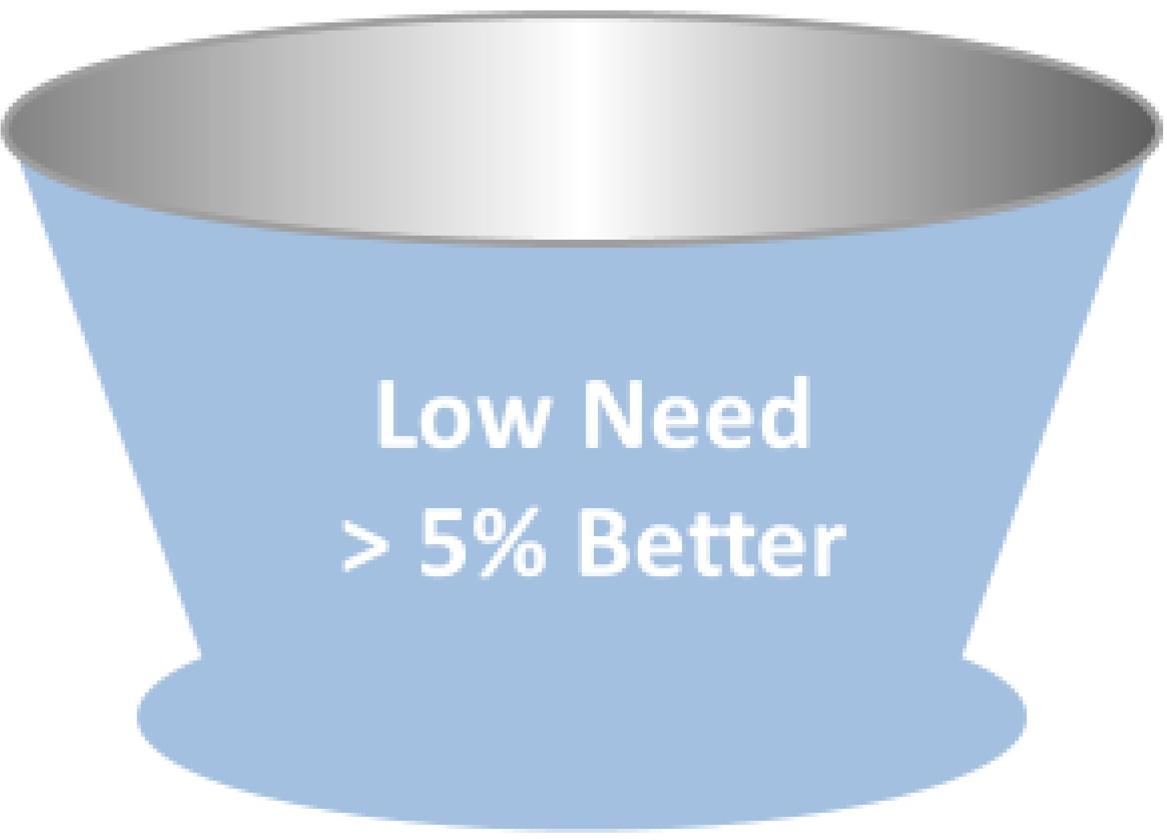
'1 Secondary Data Methodology: Performance Relative to Benchmarks
Compare to benchmarks:*
National Benchmarks/County Health Rankings & Roadmaps Model of Health
St at e-level benchmarks: North Carolina Data Portal
i, Ase NDIENT I 26
*When available, individual County data measures were compared to State-level data measures, otherwise compared to Nationa l-level data measures

Slide 10








A total of 1,253 Cumberland residents responded to the web-based survey that was dist r ibut ed as part of this primary c collection process. Almio st four out of five respondents identified as women, and the largest age group represented · 45-65 years old.
Age
Gender !Identity
Non-binary / Other
(0.1%)
50.0%
45 .0%
40.0%
34.7%
30.0%
Man ( 16.5% )
20.0%
1 3.7%
10.0%
5.1%
Woman {82.4%)
0.0%
18-24 Yea r s
25-44 Year s
45-65 Year s
65+ Yea rs
Percentage totals may not equal 100% due to the exclusion of missing or " prefer to not to answer " responses from participants
" ASCENDIENT I
r
CUMBERLAND
Department of Public Healt
cou y
NORTN (AROLINA
h
cumberlandcountync.gov/health

Slide 11








'1 Community Web Survey Results: Community Health Needs
Mental health (e.g., depression and anxiety), alcohol/drug addiction, and weight/obesity were identified as the top 3 health problems affecting the community. About one third of respondents also identified heart disease/high blood pressure and diabetes/high blood sugar as important health pro blemis.
Most Import ant Healt h Pr oblems t hat Affect the Healt h of You r Communit y
63.1%
60%
50%
49.3%
40%
39.2%
37.1 %
36.2%
30%
21.2%
20%
12.2%
1 - -
10%
9.8%
3.8%
3.2%
2.1 %
1 .8 %
1.1%
0%
Mental
health (depression/
anxiety)
Alcohol/drug Overwe ight/
addiction obesit y
Heart
disease/ hi gh blood
pressure
Diabet es/ high blood sugar
Cancer
Smoking /
tobacco use
Alz heimer ' s
disease and other
dementias
Stroke
Lung
disease/ ast hma/ COP D
Other
HIV/ AIDS Infant death
N= 1253
" Ase D ENT I 66

Slide 12









'1 Community Web Survey Results: Barriers to Care
Cost, insurance, and wait times were the top three barriers to receiving health care identified by the community.
Most Important Reason People in Your Comm1unit y Do Not Get Health Care when They Need It
90%
84.4 %
80%
70%
65.7%
60%
50%
40%
37.7 %
33.9%
30%
24.6 %
20%
10%
8.4%
5.5%
4.9%
4.1%
0%
Cost - too expensive/can't pay
No insurance
Wait is too long
Lack of transportation
Insur ance not accepted
No doct or nearby
Ot h er Reas on
Language bar r ier
Cultural/ reli gious
beliefs
-- - - - ·- NT I 67
N= 1,2 53
-_ -·

Slide 13











'1 Community Web Survey Results: Community Social/Environmental Needs
Ho using, poverty, and availability and access to doctor's offices were identified as the top three most important social or environmental problems that affect the health of the community. Insurance, neighborhood safety, and affordable child care were also identified by almost one in four respondents.
Most Important Social or Environmental Problems that Affect the Health of Your Community
45%
42.9%
40%
35%
30%
27.7%
25%
22.8%
21.7%
20.4%
20%
19.0 %
16 .8%
1 6.8%
15.6%
15%
13.7 %
10%
5%
0%
Ho us ing/ homelessness
Poverty
Ava il a bilit y/ access to
doct o r's offic·e
Av a ila bil it y/ access to insurance
Neighborhood Lack of
safe t y/ viole nce affordable child
care
Lack of Job opportunities
Racial
D is criminat ion
Tra ns port at ion problems
Limited access to healthy
foods
A Cl:N Ol t NT I 68
N= 1, Z53
The op 10 responses are illustra ed on this slide. Addi ional responses are included in report

Slide 14
'1 Focus Groups
As part of the CHNA process, four focus groups were conducted to learn more about the experiences of Cumberland County residents.
Location
Population
Fayetteville State University Students Migrant Farmworkers
CFVH Employees
Military Veterans
Date
May gth, 2024
May 22nd, 2024
May 23rd, 2024
May 29th, 2024
Virtual
Jeff Simpson Farm
Cape Fear Valley Medical Center Virtual
More than 20 community members provided feedback on health and social needs as well as their experiences !l iving, working or receiving healt hcare in Cumberland County.
Healthcare Access & Quality was identified as a common theme across these four groups. Major concerns included the high cost of heallt hcare; wait times for e1mergency care; lack of understanding how to navigate the system, particularly accessing health insurance; llac k of transportation to facilities; and lack of staffing in facilities.
" lASCENDIENT I 86

Slide 15
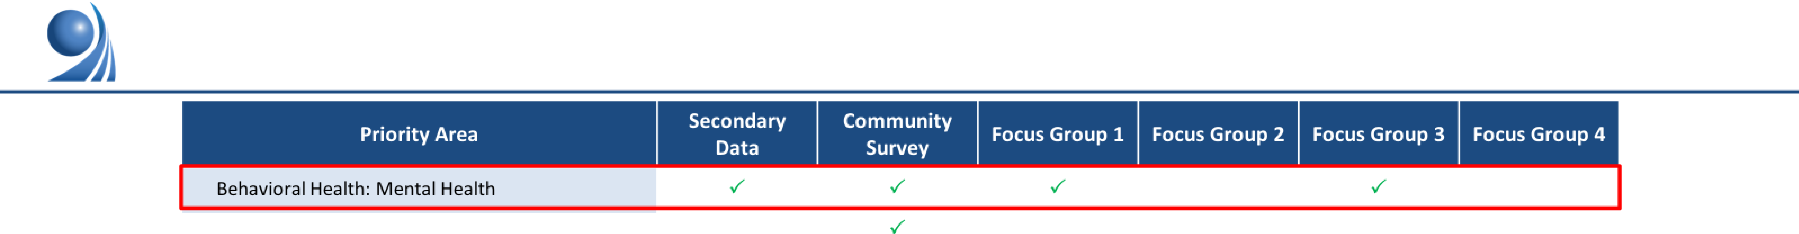
Findings Review: Identified Needs by Data Source
Behavioral Hea lt h: Substance Use Built Environment Community Safety Diet & Exercise Education | ../ ../ |  | ../ ../ |  | ../ ../
Em ployment & Income | ../ | ../ | ../ |  | ../ | ../
Environmental Quality Fa mily, Community & Social Support | ../ |  |  | ../ ../ |  | ../
Food Access & Security | ../
Hea lthcare: Access & Quality | ../ | ../ | ../ |  | ../ | ../
Hea lt h Equity & Literacy Housing & Homelessness |  | ../ |  |  | ../ | ../
Length of Life | ,/
M ate rnal & Infant Health | ,/
Physical Health (Chronic Diseases, Cancer, Obesity) | ,/ |  |  | ../
Sexual Hea lt h Tobacco Use Transportation & Transit | ,/ ,/ ,/ |  | ../ | ../ |  | ../
Analysis on additional topics of interest for Cumberland County (Income, Mental Health, Safety and Substance Use Diso rders) ,i s curren, t ly in progress. Survey resuIts captured here reflect major findings from the Community Health Op inion Survey questions. Red boxes indicates categories identified as high need across 4 or more data sources.
"Ase
DENT I 92

Slide 16
Results of Key Stakeholder Meeting
Key stakeholders convened on 9/5/2024 to review data and prioritize
results
3 Priorities selected
Behavioral health, mental health, and substance use
Physical health (chronic disease, obesity, cancer, etc.)
Maternal and infant health

Slide 17
Next Steps
BOH to solicit public comment for October meeting.
Health Education team will work with community stakeholders to
host prioritization meeting.
Public will be notified of report once completed and seek feedback via email or social media.

Slide 18


